Slide 1


wWWWw wWWWw
vVVVv (___) wWWWw (___) vVVVv
(___) ~Y~ (___) vVVVv ~Y~ (___)
~Y~ \| ~Y~ (___) |/ ~Y~
\| \ |/ \| / \~Y~/ \| \ |/
\\|// \\|// \\|/// \\|// \\|// \\\|///
^^^^^^^^^^^^^^^^^^^^^^^^^^^^^^^^^^^^^^^^

Slide 2
plant_sim_information.rb
.-.' '.-.
.-( \ / )-.
/ '..oOOo..' \
, \.--.oOOOOOOo.--./
|\ , ( :oOOOOOOo: )
_\.\/| /'--'oOOOOOOo'--'\
'-.. ;/| \ .''oOOo''. /
.--`'. :/|'-( / \ )-'
'--. `. / //'-'.__.'-;
`'-,_';// , /|
'(( |\/./_
\\ . |\; ..-'
\\ |\: .'`--.
\\, .' .--'
))'_,-'`
//-'
//
//
|/
puts
“This application enables you to take care of a virtual plant using realistic environmental variables and care methods.”
puts
“The creation and development of Plant Sim is inspired by my own experiences as a plant parent and the game logic of a Tamagotchi.”

Slide 3
Features of Plant Sim
💧 Watering - influences the growth speed and chance for bugs, once per day.
💡 Fertilising - influences the growth speed, once per game.
🐞 Pesticides - influences the chance for bugs and treats infestations, once per game.
🌞 Location - influences the speed of water depletion and growth speed.
⏳ Day Cycles - stores recurring variables and calculates growth level, water depletion, bug chance and condition flavor text.
🏆 Win or Lose Conditions - queries the growth level to see if the plant has flowered or died.

Slide 4
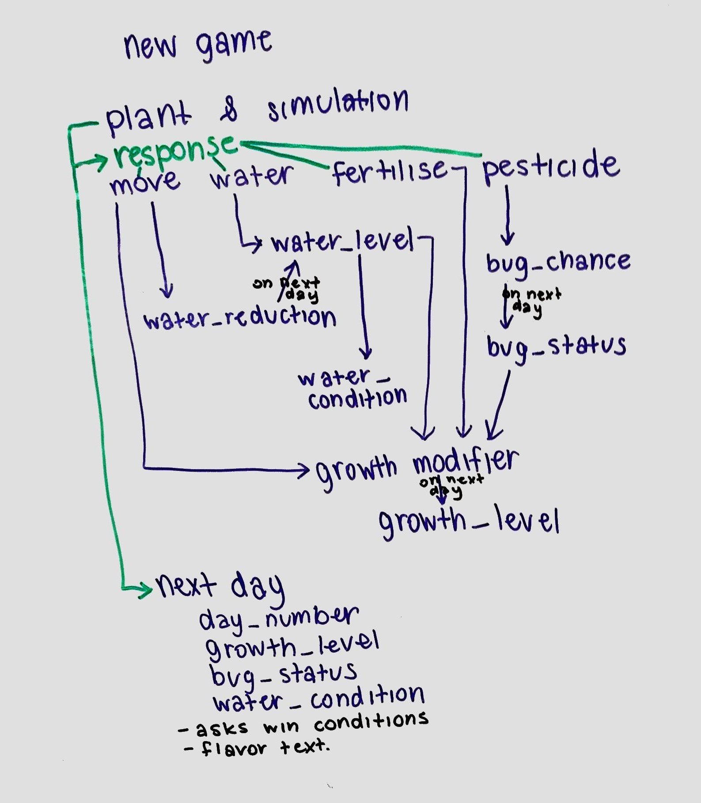
Code Logic
Asks user to start a new game.
Displays flavor text.
Asks user for a choice.
Runs choice method.
When user calls next_day method, calculates variables and growth.
Checks win conditions.
Runs win/lose sequences.

